Slide 1
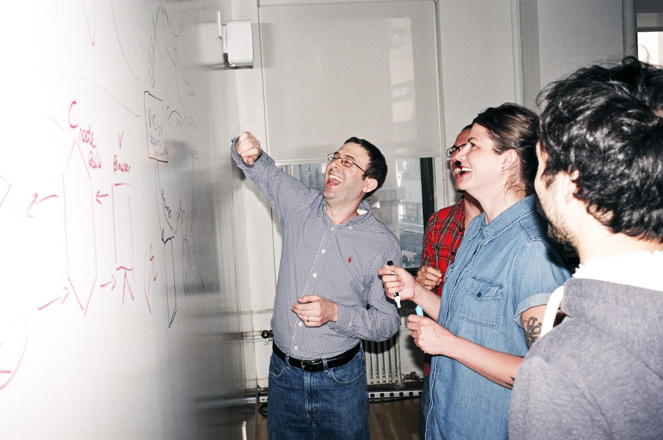

Welcome to General Assembly
WiFi GA Guest
Password yellowpencil
Notes:
[Leave this slide visible until presentation starts]

Slide 2

DATA SCIENCE
Lesson 9 - Recommendation Engines

Slide 3
Course Plan
Paul & James review final project ideas

Slide 4
Final Project Guidelines

Slide 5
DATA SCIENCE PART TIME COURSE – HALF WAY
Congratulations – you’re half-way there!
Drinks! Cake! Game!
What are Recommendations?
What is the motivation of recommendations?
What is Content-Based Filtering?
What is Collaborative Filtering?
Measuring Accuracy
Lab
Other Considerations
Discussion

Slide 6
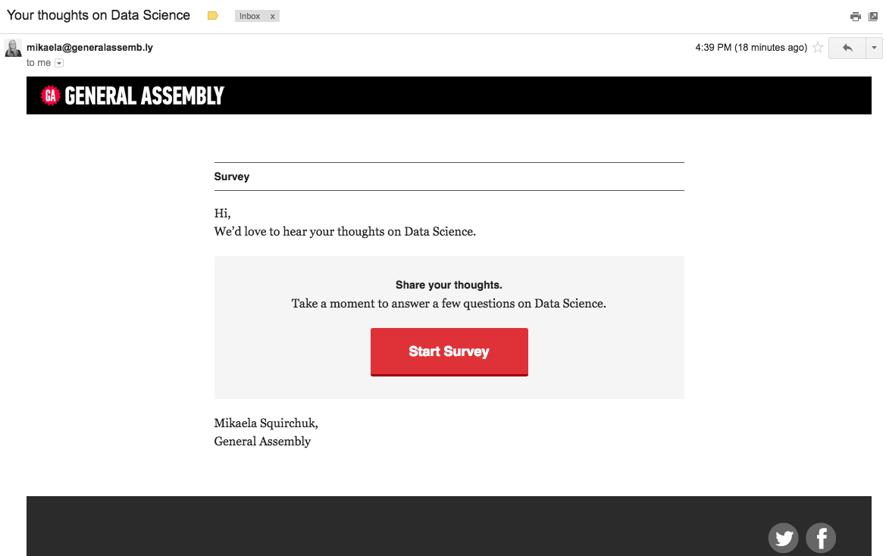
Feedback
Survey
DATA SCIENCE PART TIME COURSE

Slide 7
Git & GitHub – 1 Pager Guide!

Slide 8
WHAT ARE RECOMMENDATION ENGINES?
DATA SCIENCE PART TIME COURSE

Slide 9
RECOMMENDATION ENGINES
What are recommendations?
Why are they important?
Give one example people are likely to come across?
Work in two groups to answer the above questions and present back to the class.
5 mins

Slide 10



RECOMMENDATION ENGINES
Recommendation engines aims to match users to things (movies, songs, items, events, etc) they might enjoy but have not yet tried.
The rating is produced by analysing other user/item ratings (and sometimes item characteristics) to provide personalised recommendations to users.

Slide 11

DATA SCIENCE PART TIME COURSE

Slide 12
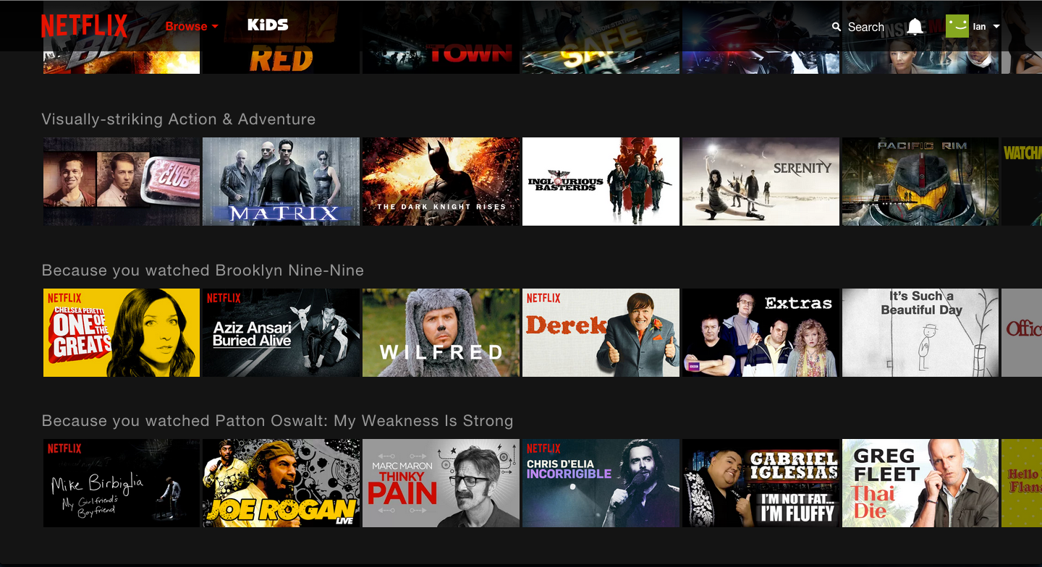
Netflix - Entertainment or Data Science?

Slide 13
Netflix - Entertainment or Data Science?

Slide 14
Netflix - Entertainment or Data Science?

Slide 15
Netflix - Entertainment or Data Science?

Slide 16

Netflix - Entertainment or Data Science?

Slide 17
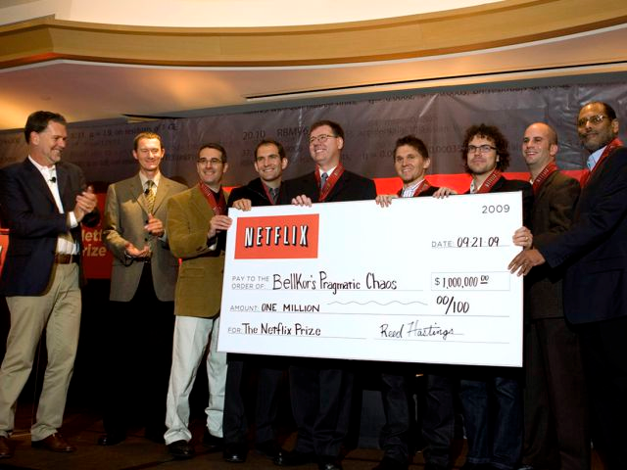
Netflix - Entertainment or Data Science?

Slide 18
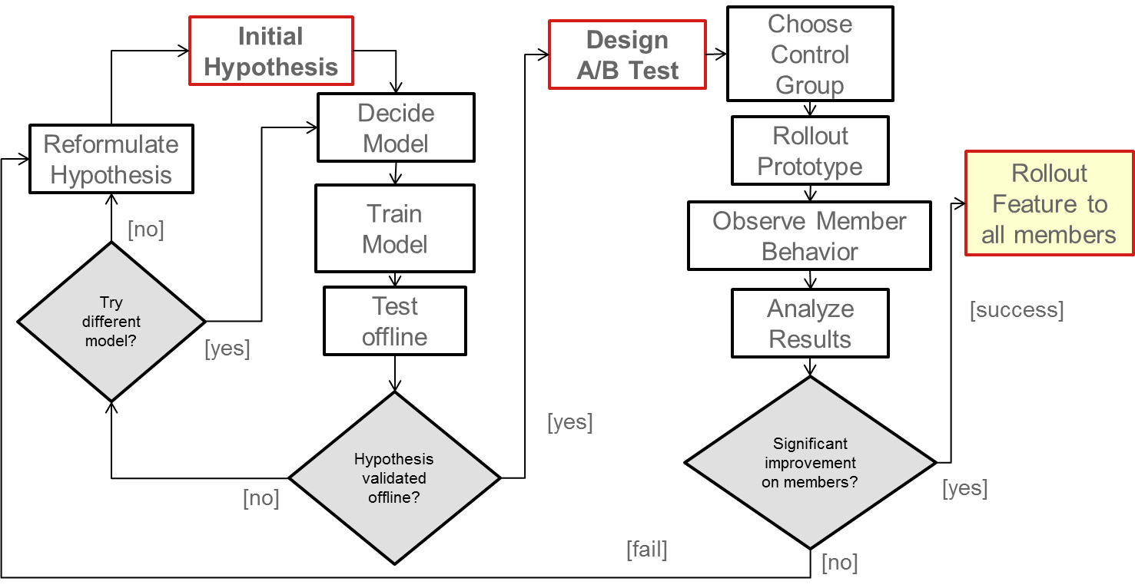
Netflix - Entertainment or Data Science?

Slide 19
RECOMMENDATION ENGINES
There are two general approaches to the design:
Content-based filtering
Items are mapped into a feature space, and recommendations depend on item characteristics (action / thriller / RomCom
cast, reality vs fiction etc)
Collaborative filtering
Item ratings & recommendations based upon user preferences

Slide 20
CONTENT-BASED FILTERING
DATA SCIENCE PART TIME COURSE

Slide 21
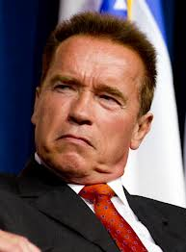


CONTENT-BASED FILTERING
Looking at attributes of an item, you then make recommendations based on how similar those items are.
You liked Predator with Arnold Schwarzenegger you might also like The Terminator (because Arnie’s in that too).

Slide 22
CONTENT-BASED FILTERING
Content-based filtering begins by mapping each item into a feature space. Both users and items are represented by vectors in this space.
Item vectors measure the degree to which the item is described by each feature, and user vectors measure a user’s preferences for each feature.
Ratings are generated by taking dot products of user & item vectors.

Slide 23
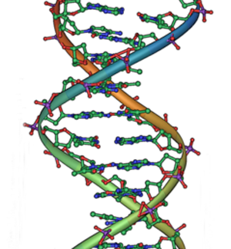
CONTENT-BASED FILTERING
Pandora is an example of Content-Based filtering. A massive taxonomy of musical information. Trained musical analysts identify over 450 musical characteristics (lookup the Music Genome Project).

Slide 24
CONTENT-BASED FILTERING
Content-based filtering has some difficulties:
Must map items into a feature space (manual work)
Recommendations are limited in scope (items must be similar to each other)
Hard to create cross-content recommendations (eg books/music films...this would require comparing elements from different feature spaces)

Slide 25
COLLABORATIVE FILTERING
DATA SCIENCE PART TIME COURSE

Slide 26
COLLABORATIVE FILTERING
“Customers who purchased X also purchased Y”
Someone with similar tastes to you will be able to recommend things you might like, e.g. people who watch ‘The Newsroom’ will probably enjoy ‘The Social Network’ because there is a large audience in common.

Slide 27
COLLABORATIVE FILTERING
Collaborative filtering refers to a family of methods for predicting ratings where instead of thinking about users and items in terms of a feature space, we are only interested in the existing user-item ratings themselves.
In this case, our dataset is a ratings matrix whose columns correspond to items, and whose rows correspond to users.

Slide 28
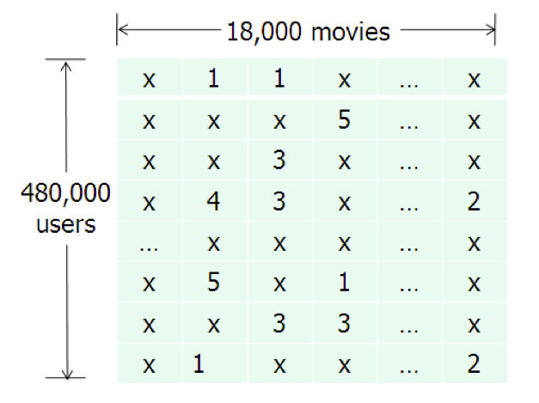
COLLABORATIVE FILTERING
This will be the general form of the data we analyse for collaborative filtering.
The method relies on previous user-item ratings (or feedback).

Slide 29
COLLABORATIVE FILTERING
Collaborative filtering is susceptible to the Cold Start problem.
What happens if we don’t have any (or enough) reviews?

Slide 30
COLLABORATIVE FILTERING
Collaborative filtering is susceptible to the Cold Start problem.
What happens if we don’t have any (or enough) reviews?
Until users rate several items, we don’t know anything about their preferences.
We can get around this by enhancing our recommendations using implicit feedback, which may include things like item browsing behaviour, search patterns, purchase history, etc. Or by using a hybrid model.

Slide 31
SIMILARITY SCORES
DATA SCIENCE PART TIME COURSE

Slide 32
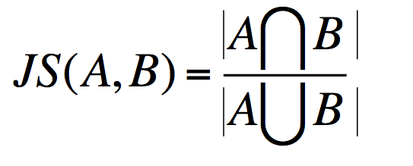
JACCARD SIMILARITY
Jaccard Similarity defines similarity between two sets of objects

Slide 33
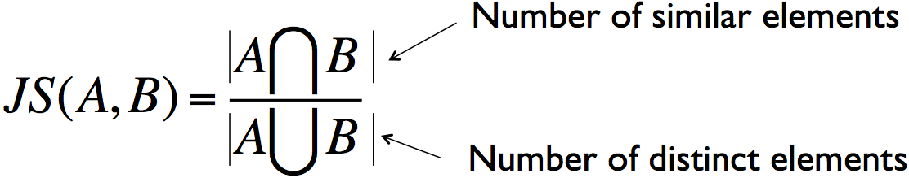
JACCARD SIMILARITY
Jaccard Similarity:
Defines similarity between two sets of objects
Total

Slide 34
JACCARD SIMILARITY
JS ({1, 2, 3}, {2,3,4}) = {2,3} / {1,2,3,4}
= 2/4
= 1/2

Slide 35
JACCARD SIMILARITY
User one: {“LG-LCDTV 52” ”,“Blu Ray Player”,“HDMI Cable”}
User two: {“LG-LCDTV 52”,“Sony PS4”,“HDMI Cable”}
JS (User one, User two) =

Slide 36
JACCARD SIMILARITY
User one: {“LG-LCDTV 52” ”,“Blu Ray Player”,“HDMI Cable”}
User two: {“LG-LCDTV 52”,“Sony PS4”,“HDMI Cable”}
JS (User one, User two) = 2/4
= 1/2

Slide 37
LAB
DATA SCIENCE PART TIME COURSE
Lab 9 Recommendation Engines.ipynb

Slide 38
OTHER CONSIDERATIONS
DATA SCIENCE PART TIME COURSE

Slide 39
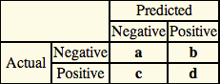
MEASURING ERROR
Accuracy = Correct Recommendations / Total Possible Recommendations
= (a + d )/(a + b +c + d)
Precision = Correctly Predicted Relevant results / Total Predicted Relevant
= d / (b + d)
Recall = Correctly Predicted Relevant results / Total Actual Relevant
= d / (c + d)
Precision ~1 means the algorithm returned more relevant results than irrelevant.
Recall ~1 means that an algorithm returned most of the relevant results.

Slide 40

EXPLICIT VS IMPLICIT DATA
Explicit data is when you ask the user to rate something, e.g. 1-5 star rating for a movie
Implicit data is when you observe a users behaviour and record

Slide 41
DISCUSSION TIME
Week 4 Review
Final Project 2
Pre-reading
Halfway Review
Project
DATA SCIENCE

Slide 42
DISCUSSION TIME
Regularisation
Why do we do this?
Name 1x type of regularised regression?
How does it work?
Clustering
Why do we do this?
How does k-means work?
WEEK 4 - Review

Slide 43
PRE-READING
AirBnB article on AutoML: https://medium.com/airbnb-engineering/automated-machine-learning-a-paradigm-shift-that-accelerates-data-scientist-productivity-airbnb-f1f8a10d61f8
Lesson 9 - Review

